Slide 1
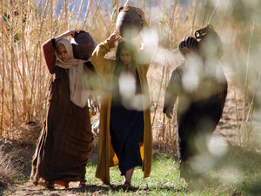

Slide 2
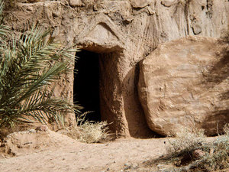

Slide 3
“Why are you looking for a living person here? This is a place for the dead. Jesus is not here. He has risen from death! Do you remember what he said in Galilee? He said that the Son of Man must be given to evil men, be killed on a cross, and rise from death on the third day.”

Slide 4
