Slide 1
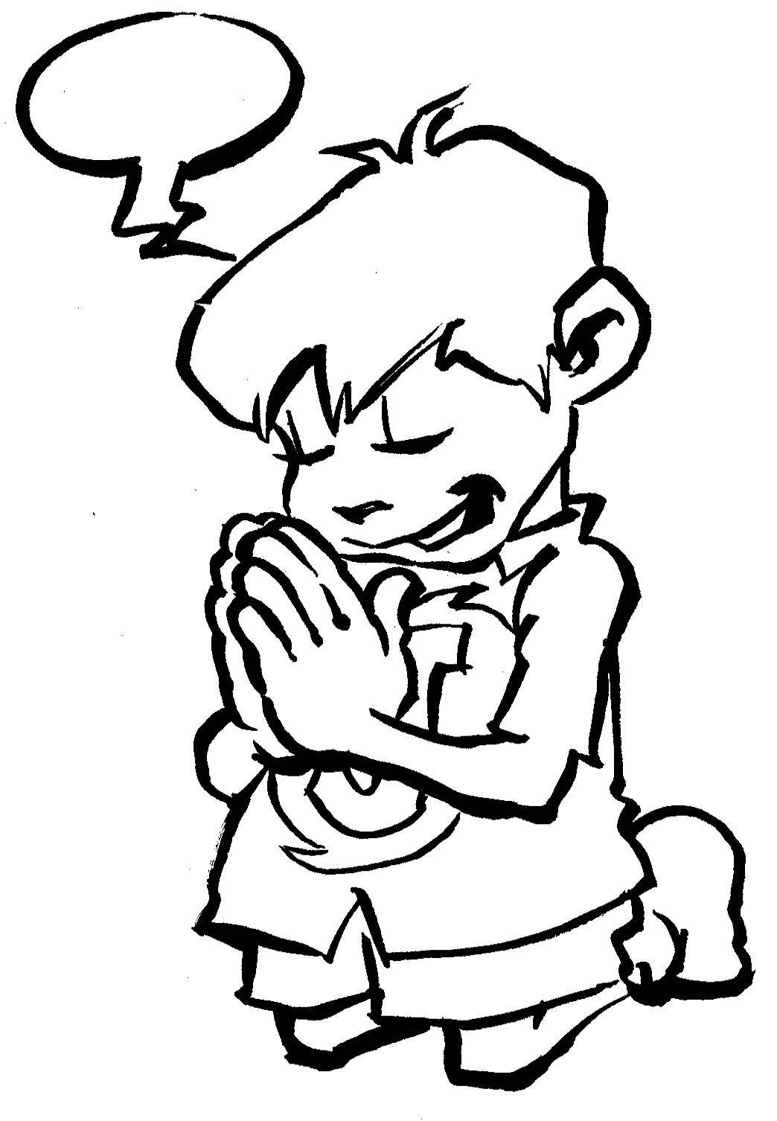

Slide 2
Pray in the Spirit at all times. Pray with all kinds of prayers, and ask for everything you need. To do this you must always be ready. Never give up. Always pray for all God’s people. Ephesians 6: 18

Slide 4
Sorry
Thank you
Others
Please

