Slide 2
The most wonderful moment in History!
“He was a good, God-fearing man and was waiting for Israel to be saved. The Holy Spirit was with him ²⁶ and had assured him that he would not die before he had seen the Lord's promised Messiah.”

Slide 3
The most wonderful moment in History!
“He was a good, God-fearing man and was waiting for Israel to be saved. The Holy Spirit was with him ²⁶ and had assured him that he would not die before he had seen the Lord's promised Messiah.”

Slide 4
The most wonderful moment in History!
“He was a good, God-fearing man and was waiting for Israel to be saved. The Holy Spirit was with him ²⁶ and had assured him that he would not die before he had seen the Lord's promised Messiah.”

Slide 5
The most wonderful moment in History!
²⁷Led by the Spirit, Simeon went into the Temple

Slide 7
The most wonderful moment in History!
²⁹ “Now, Lord, you have kept your promise, and you may let your servant go in peace.”

Slide 8
1. Jesus is God’s salvation for all
³⁰ With my own eyes I have seen your salvation, ³¹ which you have prepared in the presence of all peoples:

Slide 9
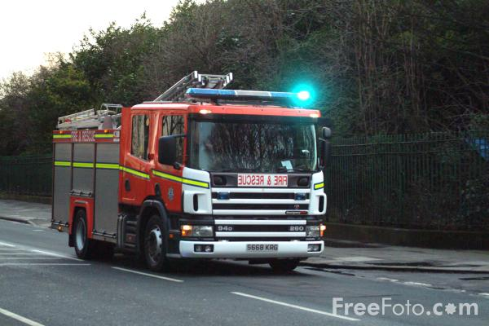

Slide 10
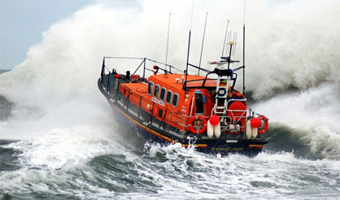

Slide 11
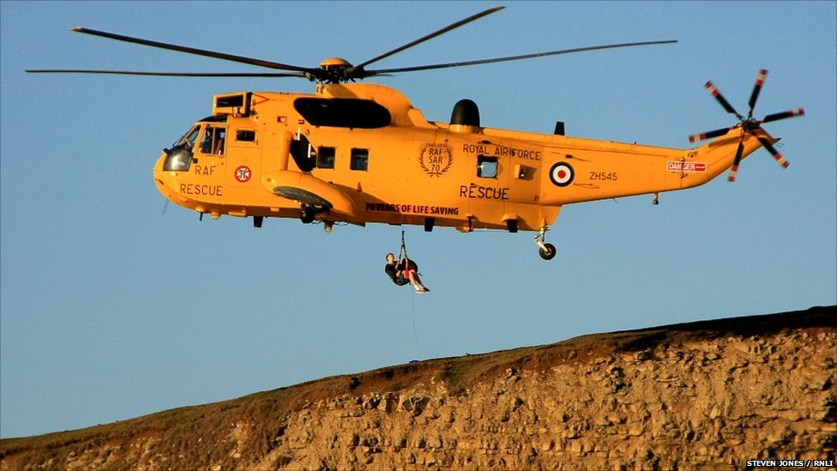

Slide 12
1. Jesus is God’s salvation for all
³⁰ With my own eyes I have seen your salvation,³¹ which you have prepared in the presence of all peoples:

Slide 13
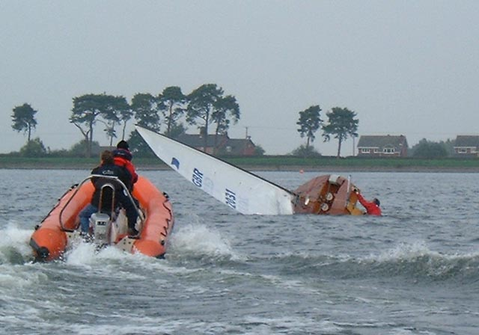

Slide 14
1. Jesus is God’s salvation for all
³⁰ With my own eyes I have seen your salvation,³¹ which you have prepared in the presence of all peoples:

Slide 15
2. Jesus reveals God to all
³² A light to reveal your will to the Gentiles and bring glory to your people Israel.”

Slide 17
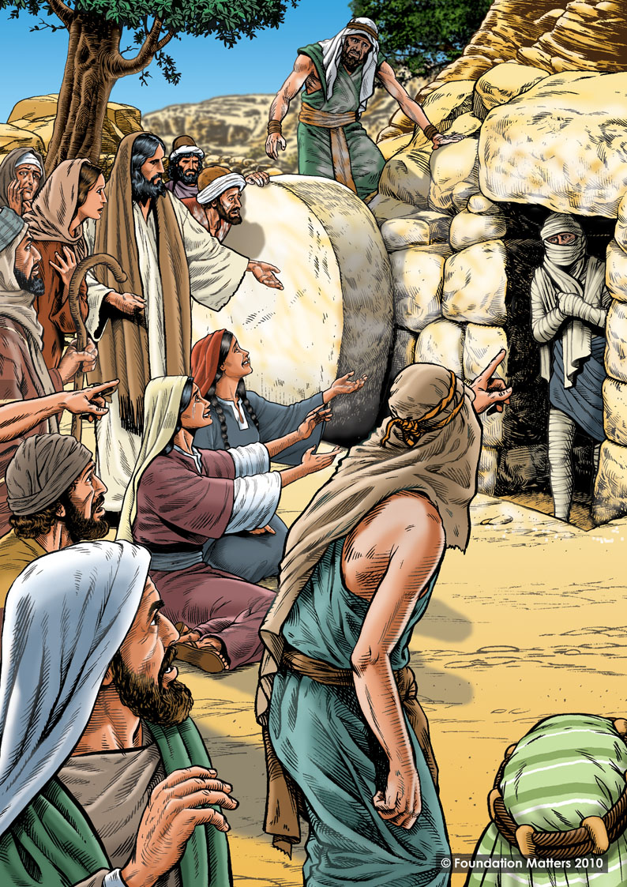

Slide 19
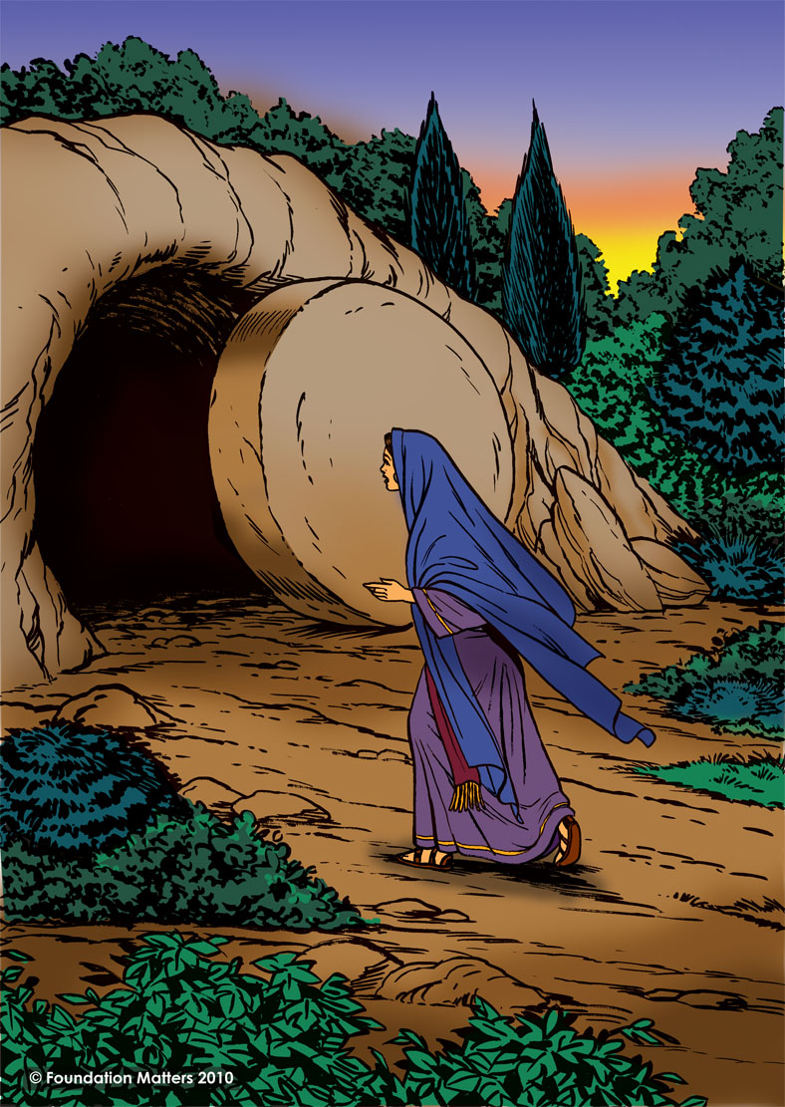

Slide 20
2. Jesus reveals God to all
³² A light to reveal your will to the Gentiles and bring glory to your people Israel.”

Slide 21
Jesus reveals our secret thoughts
“This child is chosen by God for the destruction and the salvation of many in Israel. He will be a sign from God which many people will speak against ³⁵ and so reveal their secret thoughts.”

Slide 22
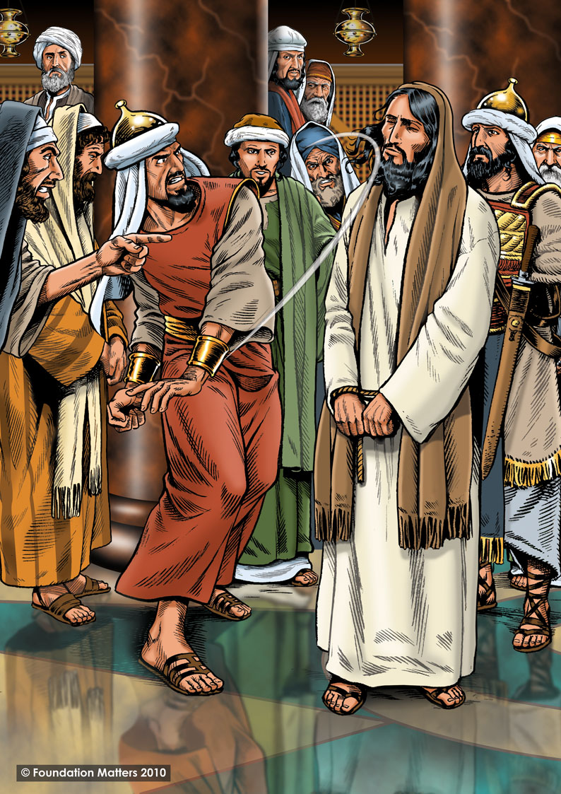

Slide 23
Jesus reveals our secret thoughts
“This child is chosen by God for the destruction and the salvation of many in Israel. He will be a sign from God which many people will speak against ³⁵ and so reveal their secret thoughts.”

Slide 24
The waiting is over!

