Slide 1
The Nativity Meet the People

Slide 2
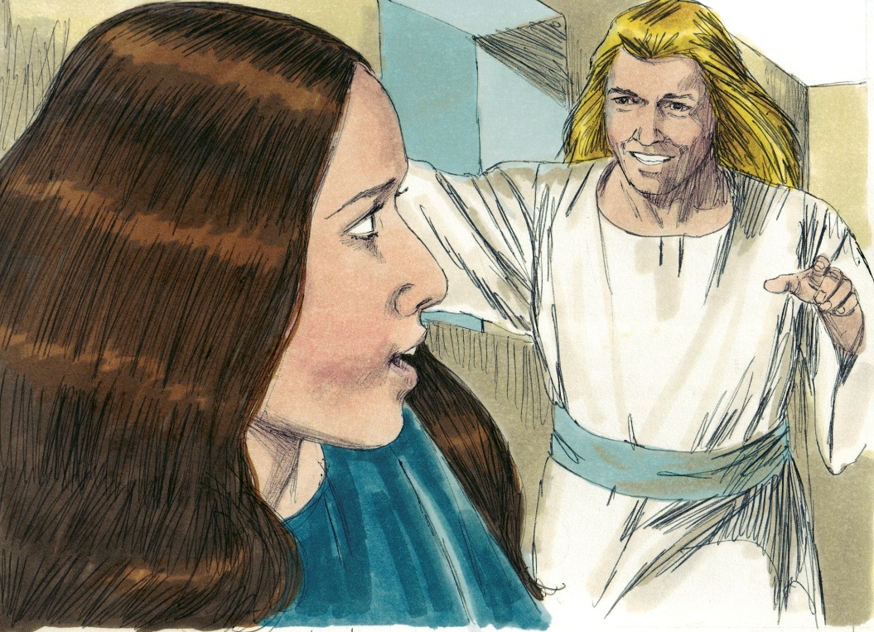
Angel:
Good news!

Slide 3
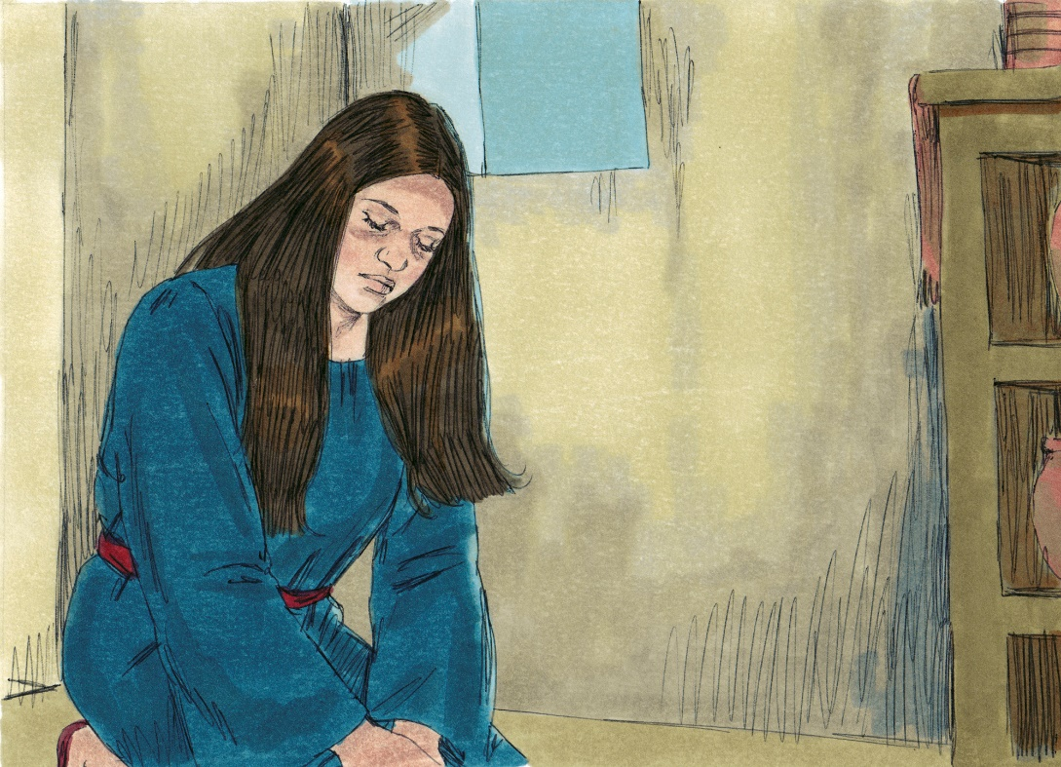
Mary:
Trusted

Slide 4
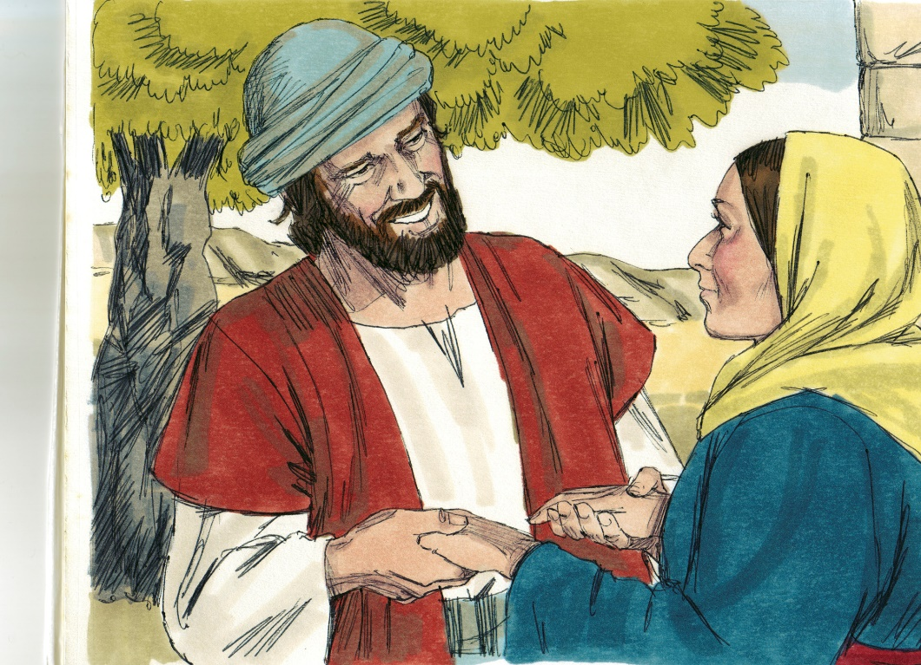
Joseph:
Obeyed

Slide 5
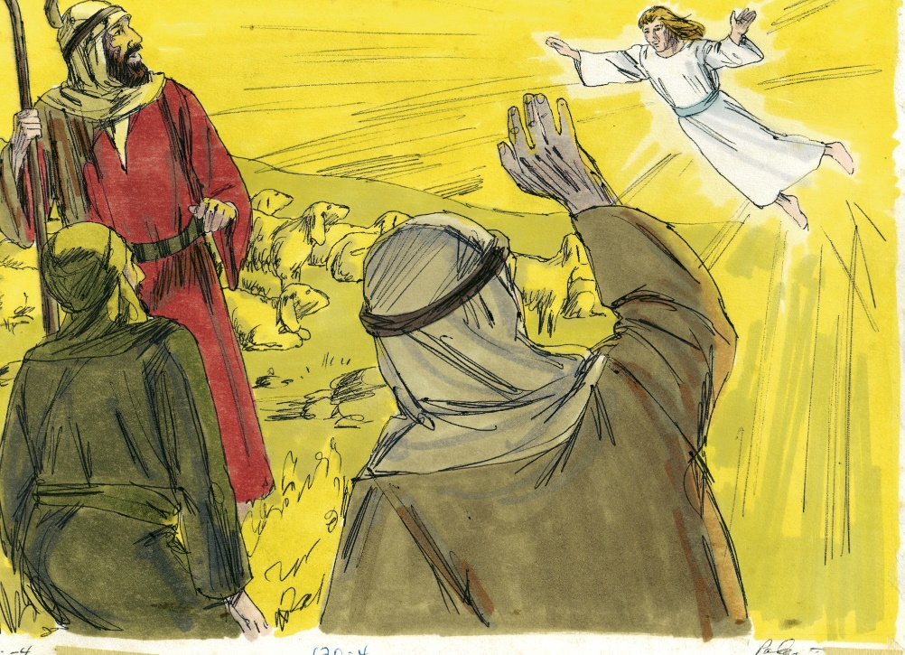
Shepherds:
Told everyone!

Slide 6
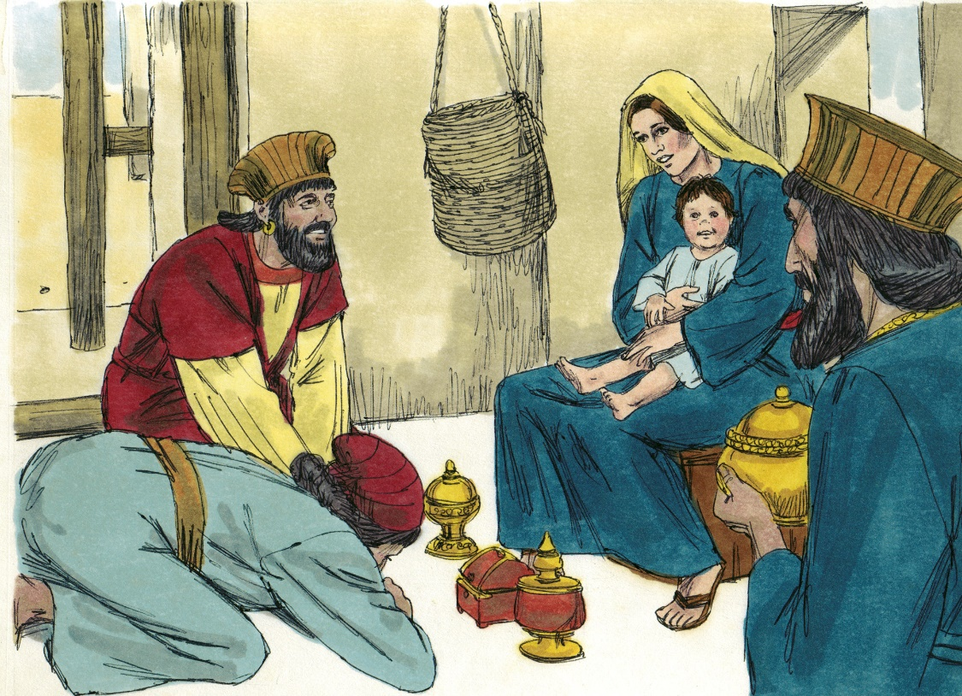
Wise men:
Worshipped!

Slide 7
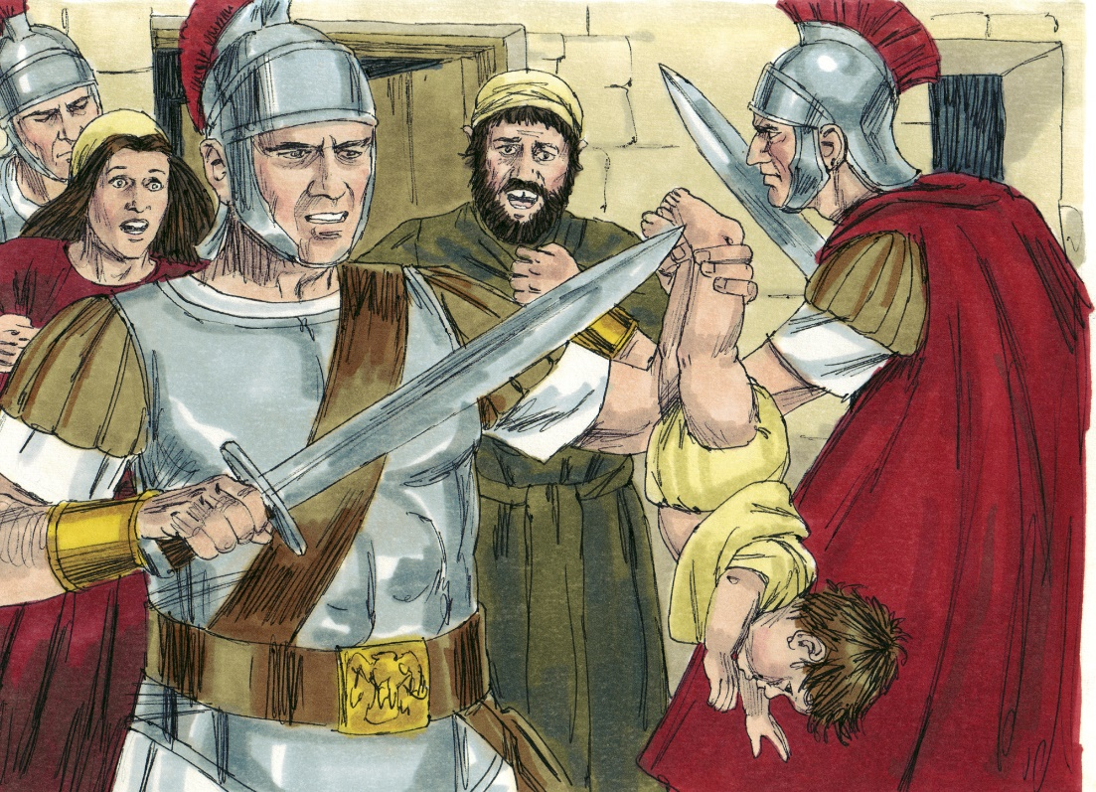
Herod:
Hated!

